Slide 1
Healthy Churches guard the gospel
1 Timothy 1:12-20
Preached by Dr. Jim Harmeling at Crossroads International Church Singapore • cicfamily.com Uploaded by Dr. Rick Griffith • Singapore Bible College Thousands of files in 49 languages for free at BibleStudyDownloads.org

Slide 3
Healthy Church Life
Studies in 1 Timothy

Slide 4
Healthy Churches guard the gospel
1 Timothy 1:12-20

Slide 5
They protect the message
1 Timothy 1:1-11
Recognize authority
Don’t get distracted from goal
Retain the Law

Slide 6
They live the message
1 Timothy 1:12-20

Slide 7
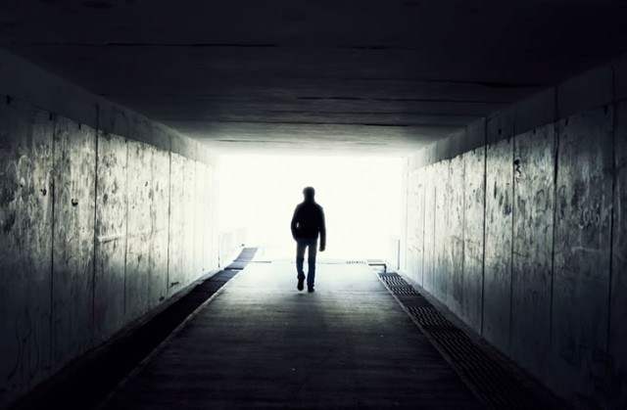
Apply the gospel to your own life (1:12-17)
Credit God for life change (v. 12)
Recall pre-conversion state (v. 13)

Slide 8
Acts 22:3-5
³ “I am a Jew, born in Tarsus in Cilicia, but brought up in this city, educated at the feet of Gamaliel according to the strict manner of the law of our fathers, being zealous for God as all of you are this day. ⁴ I persecuted this Way to the death, binding and delivering to prison both men and women, ⁵ as the high priest and the whole council of elders can bear me witness. From them I received letters to the brothers, and I journeyed toward Damascus to take those also who were there and bring them in bonds to Jerusalem to be punished.

Slide 9
Acts 26:9-11
⁹ “I myself was convinced that I ought to do many things in opposing the name of Jesus of Nazareth. ¹⁰ And I did so in Jerusalem. I not only locked up many of the saints in prison after receiving authority from the chief priests, but when they were put to death I cast my vote against them. ¹¹ And I punished them often in all the synagogues and tried to make them blaspheme, and in raging fury against them I persecuted them even to foreign cities.

Slide 10
Insolent opponent - hubris
“The corresponding abstract noun is hubris, which Aristotle defines: ‘Hubris means to hurt and to grieve people, in such a way that shame comes to the man who is hurt and grieved, and not that the person who inflicts the hurt and injury may gain anything else in addition to what he already possesses, but simply that he may find delight in his own cruelty and in the suffering of the other person.’”
William Barclay

Slide 11
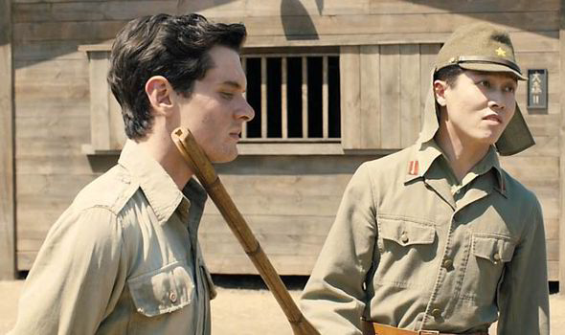

Slide 12
Apply the gospel to your own life (1:12-17)
Credit God for life change (v. 12)
Recall pre-conversion state (v. 13)
Explain how God changed you (v. 14)

Slide 13
Philippians 1:29
“For it has been granted to you that for the sake of Christ you should not only believe in him but also suffer for his sake”
Romans 2:4
“Or do you presume on the riches of his kindness and forbearance and patience, not knowing that God's kindness is meant to lead you to repentance?”

Slide 14
Apply the gospel to your own life (1:12-17)
Credit God for life change (v. 12)
Recall pre-conversion state (v. 13)
Explain how God changed you (v. 14)
Declare that the gospel saves all sinners (v. 15)
Reassure that Jesus is patient (v. 16)
Offer praise to Christ for life change (v. 17)

Slide 15
Apply the gospel to your own life (1:12-17)
Challenge believers to remain steadfast in faith (1:18-20)
Corporate accountability helps us remain steadfast (v. 18)
Our conscience helps us remain steadfast (v. 19a)
Fatal examples help us remain steadfast (vs. 19b-20)

Slide 17
NT Preaching • BibleStudyDownloads.org
Get this presentation for free!

